Slide 1
Predicting the energy output of wind turbine based on weather condition
:IBM Hack Challenge 2020

Slide 2
Project Description:
Wind energy plays an increasing role in the supply of energy world-wide. The energy output of a wind farm is highly dependent on the wind conditions present at its site. If the output can be predicted more accurately, energy suppliers can coordinate the collaborative production of different energy sources more efficiently to avoid costly overproduction.

Slide 3
Wind turbine power output is known to be a strong function of wind speed, but is also affected by turbulence and shear. In this work, new aerostructural simulations of a generic 1.5 MW turbine are used to rank atmospheric influences on power output. Most significant is the hub height wind speed, followed by hub height turbulence intensity and then wind speed shear across the rotor disk. These simulation data are used to train regression trees that predict the turbine response for any combination of wind speed, turbulence intensity, and wind shear that might be expected at a turbine site.

Slide 4

A wind turbine's blades sweep through a circular disk, known as the rotor disk (figure 1). The power output by a wind turbine is a function of the kinetic energy flux through the rotor disk and the efficiency with which that energy can be captured. If the wind has an instantaneous speed u that is uniform throughout a rotor disk of diameter d, the power captured is:

Slide 5
However, real wind turbines do not achieve this theoretical limit. Their performance is a function of aerodynamics and the need to limit power capture once the rated generator power is reached, at 'rated' wind speed. The generator power, turbine diameter and blade shape are optimized based on site characteristics such as annual average wind speed and the wind speed distribution. Turbine manufacturers measure their turbine's 'power curve'—the relationship between power output and wind speed—at turbine test site

Slide 6

We perform different Machine Learning algorithms on the dataset and made our project goes through four stages like
Data collection
Data preprocessing
Model Building
Application Building

Slide 7
I used T1.csv dataset which is downloaded from Kaggle.com.
It contains different columns such as :
Date/Time,LV ActivePower (kW),Wind Speed (m/s),Theoretical_Power_Curve (KWh),
Wind Direction (°).

Slide 8
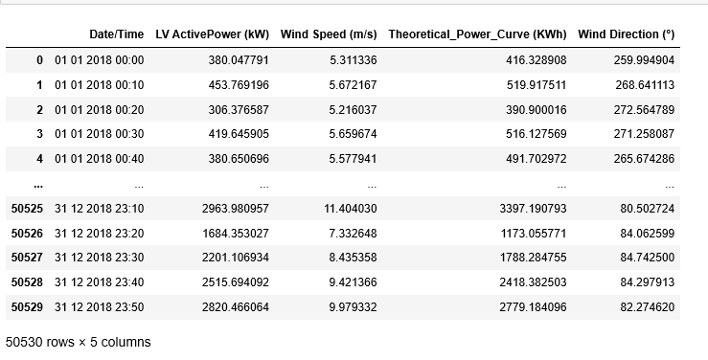

Slide 9
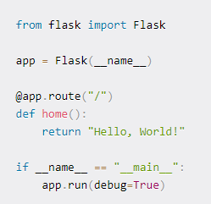
I used flask to build application and spyder to write my python code.
Flask makes the process of designing a web application simpler. Flask lets us focus on what the users are requesting and what sort of response to give back.

Slide 10
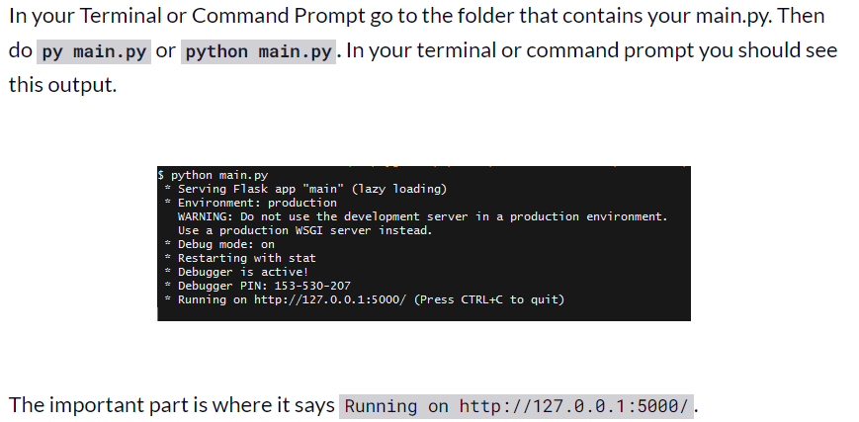

Slide 11
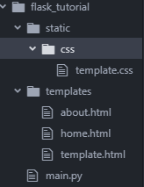
And also flask folder contains html and css codes which is present in template and static folders respectively.

Slide 12
Thank you!!

